Slide 1

Mobile App Development 01
Test.me
20203876 | 최성민
20220320 | 성연지
20226545 | 이주연

Slide 2
Chapter 1. | Team Introduction
Chapter 2. | Topic Motivation
Chapter 3. | Topic Introduction
Chapter 4. | Requirements
Chapter 5. | Project Plan
Table of Contents

Slide 3



Chapter 1
Team Introduction
Test.me
최성민
Full-stack developer of the Casting application, now in live service.
Handled both backend and frontend implementation.
-Back-
성연지
Worked on backend image processing for an open-source software project.
Currently responsible for the frontend of a capstone project using React.
-Front-
이주연
Developed a cross-platform application using Flutter in a capstone project.
Served as the frontend developer responsible for UI and interaction design.
-Front-

Slide 4
Chapter 2
Topic Motivation
Test.me
In the past, we used test books and mock exams to prepare for tests, but for university exams, there were no suitable problems to practice with.
Prepare
Test book
Mock exam
" ??? "
Test
Elementary, middle, and high school exams
College Scholastic Ability Test
Exams at university

Slide 5
Chapter 2
Topic Motivation
Test.me
To solve this, an AI tool called "NotebookLM" was created.
Prepare
Test book
Mock exam
"NotebookLM"
Test
Elementary, middle, and high school exams
College Scholastic Ability Test
Exams at university

Slide 6
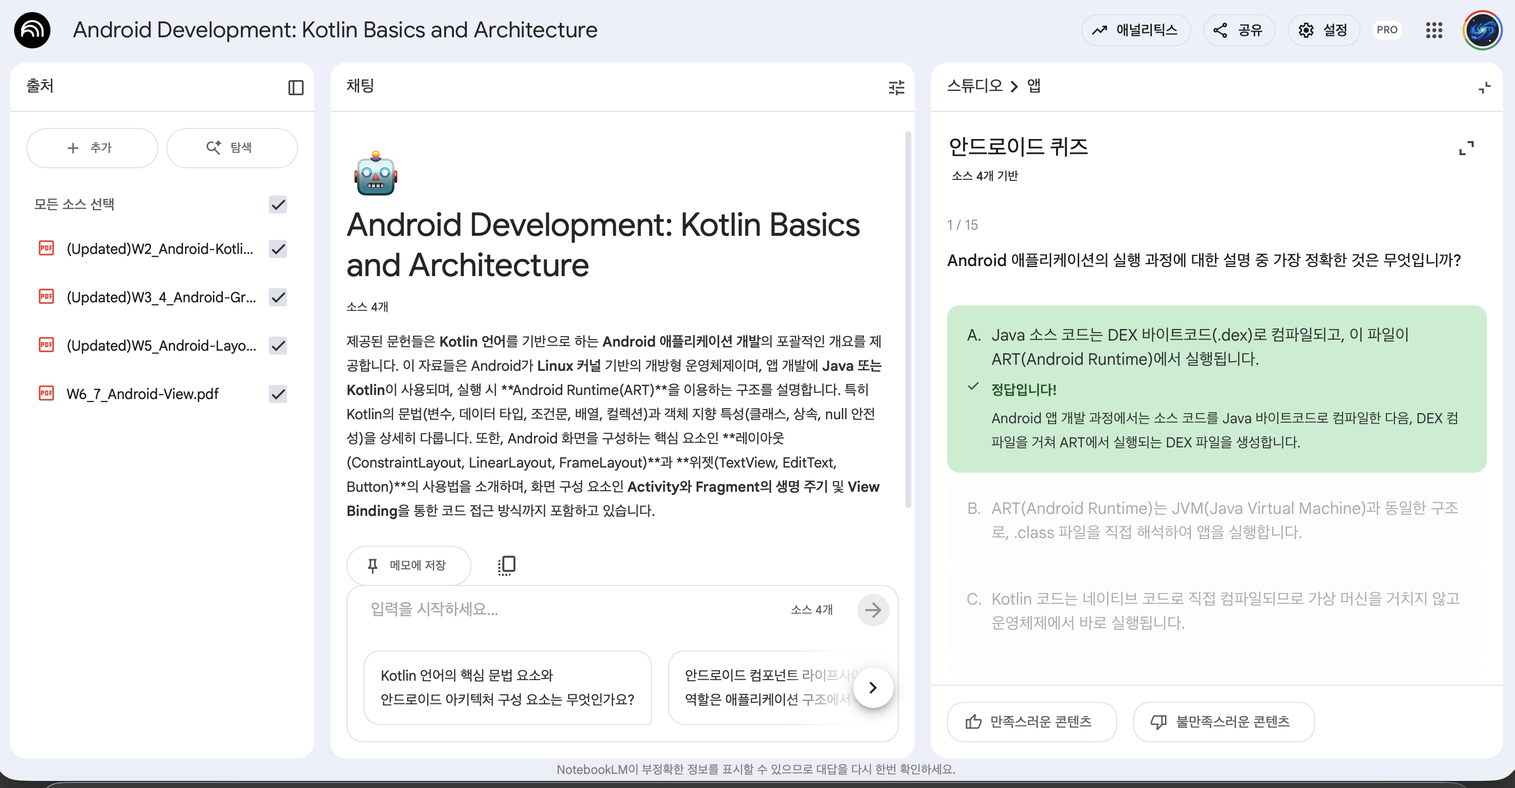
Chapter 2
Topic Motivation
Test.me
NotebookLM is an AI tool that generates summaries and study materials from uploaded content.

Slide 7


Chapter 2
Topic Motivation
Test.me
NotebookLM is an AI tool that generates summaries and study materials from uploaded content.
But some unpleasant..
Only multiple choice questions
Create problems that have already been solved

Slide 8
Chapter 3
Topic Introduction
Test.me
Therefore, we decided to develop a mock test generation app
that improves these inconveniences — we call it...
"Test.me"
This app generates short-answer questions and never repeats the ones created before. It also allows users to review the questions they have previously solved.

Slide 9

Chapter 3
Topic Introduction
Test.me
Users can upload a PDF (such as an assignment) or enter text to suggest the type of questions they want to solve.
1
Users choose the difficulty level _High (exam-level), Medium (assignment-level), or Low (concept-check)_ and the number of questions to generate.
2
The system generates short-answer questions(not previously generated) and creates a test similar to a real mock exam.
3
After answering, users receive instant scoring along with detailed explanations for each question.
4

Slide 10
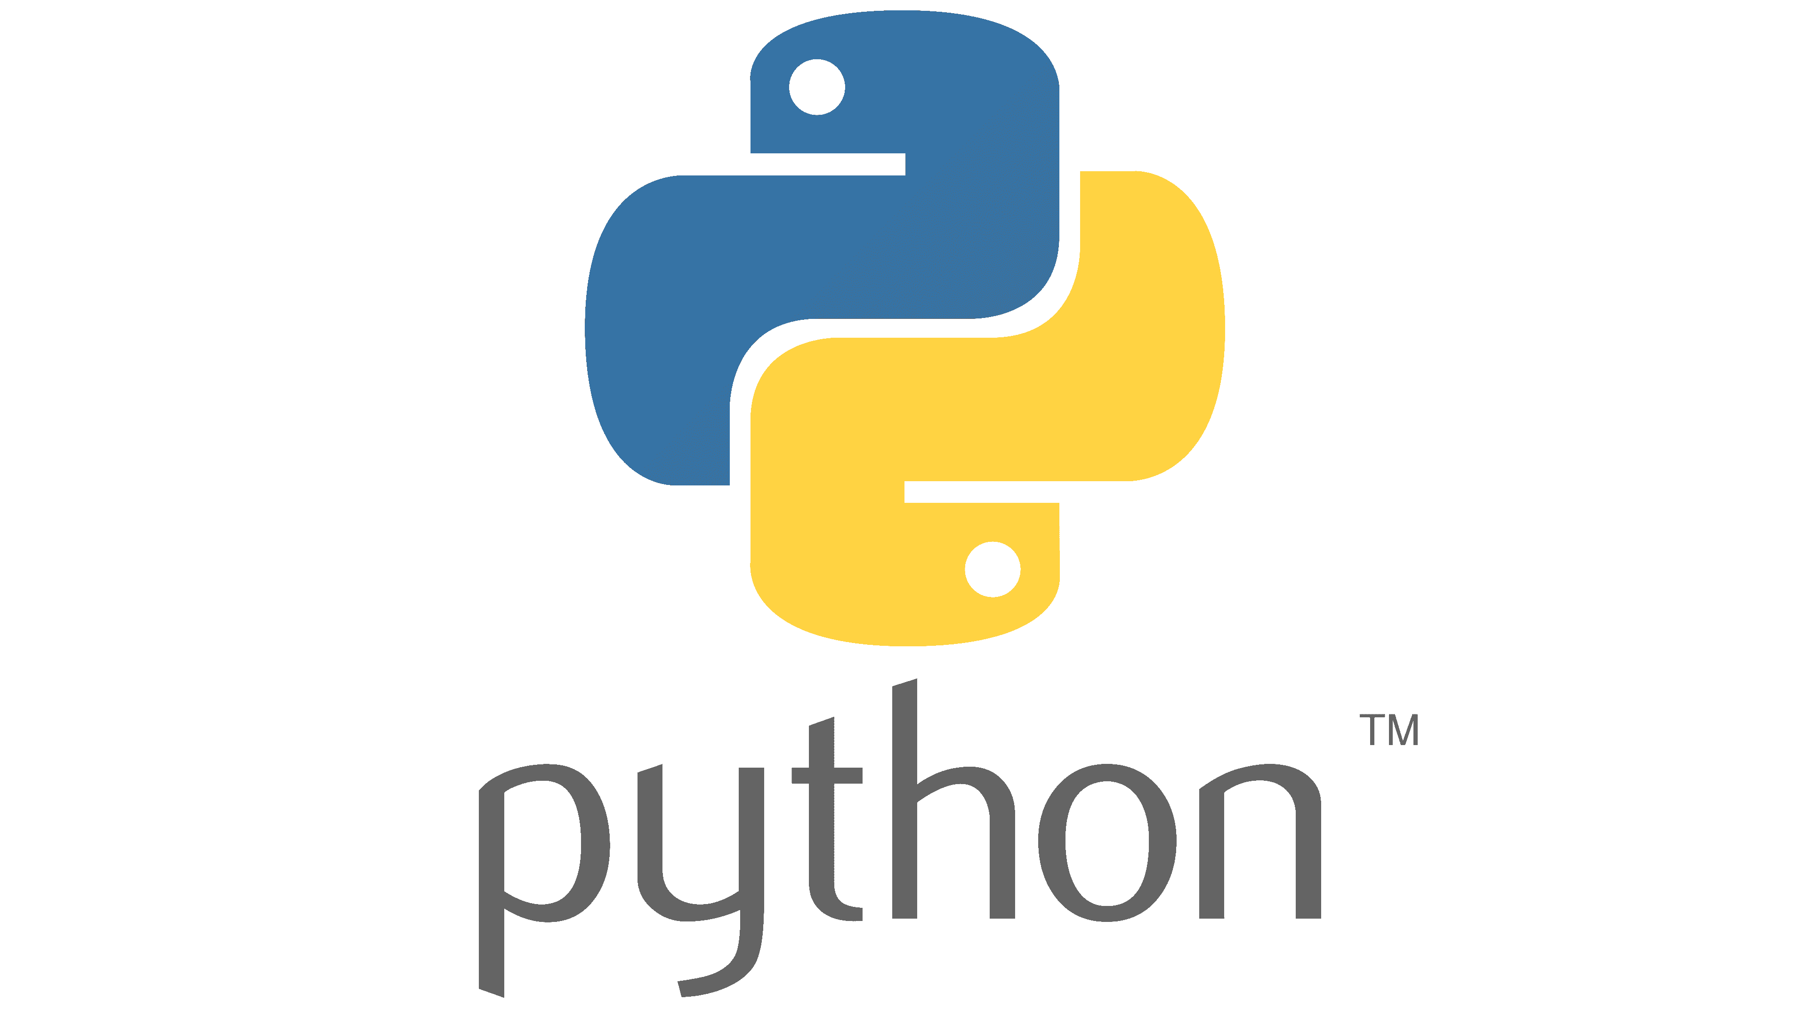

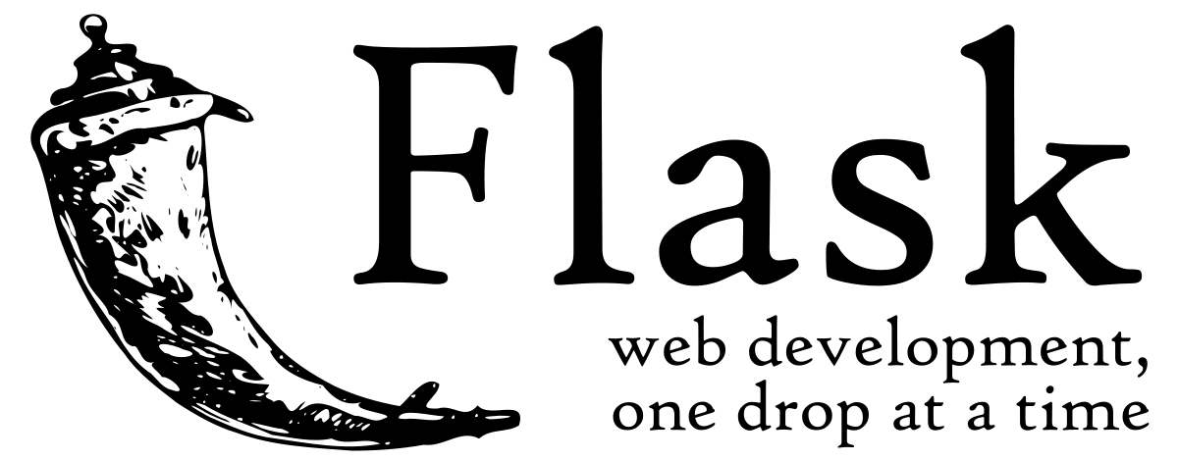


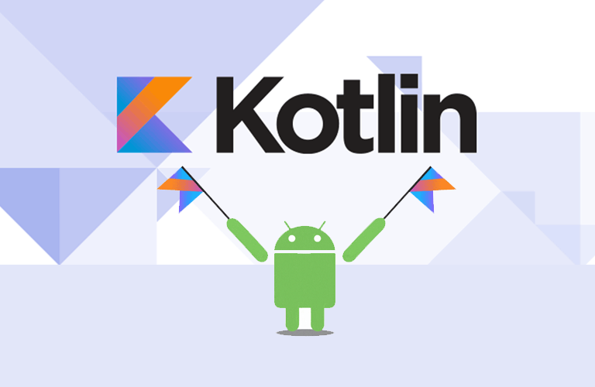
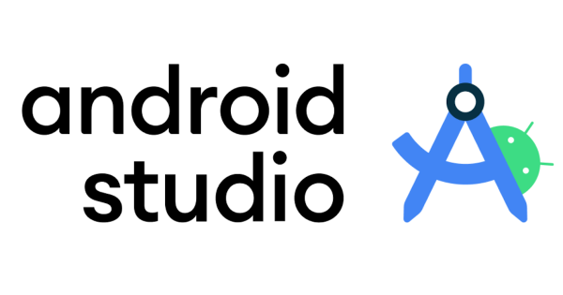
Chapter 4
Requirements
Test.me
Backend (Server & AI)
Python – Core programming language
Flask – Backend framework for API development
OpenAI – AI model Provider
Firebase – Hosting & authentication
Cloud Firestore – Database
Frontend (App Development)
Android Studio – Main development environment (IDE)
Kotlin – Mobile app programming language

Slide 11
Chapter 5
Project Plan
Test.me
Week 1
Wireframe Design
Week 2
Backend Develop
& Learning
Week 3
Core Implementation
12/30
Completion-Goal
• Design overall app layout and user flow​
• Define key screens and navigation structure
• Set up Flask backend and Firebase integration
• Connect with OpenAI API for AI model testing
• Study API behavior and data flow
• Connect Android frontend with Flask backend
• Implement major features and UI interactions
• Finalize feature development
• Start working on the document

Slide 12
Test.me
Thank You

